Slide 1
Cloud Computing
Introduction to Cloud Computing

Slide 2
What is Cloud Computing ?
Different perspectives
Properties and characteristics
Benefits from cloud computing
Service and deployment models
Three service models
Four deployment models

Slide 3

What is Cloud Computing ?

Slide 4
What is cloud computing….. Cloud computing is the delivery of computing services—servers, storage, databases, networking, software and more—over the Internet (“the cloud”). Companies offering these computing services are called cloud providers and typically charge for cloud computing services based on usage, similar to how you are billed for water or electricity at home.

Slide 5
Cloud Computing In A Nutshell
Virtualization means delivering useful functions while hiding how internals work
Being fully virtualized, computing must allow computers to be built from distributed components
e.g., processing, storage, data, and software resources
Cluster, grid, and now, cloud computing, have all aimed at allowing access to large amounts of computing power in a fully virtualized manner
By aggregating resources
By offering a single system view
Notes:
1.1 CLOUD COMPUTING IN A NUTSHELL

Slide 6
Cloud Computing In A Nutshell (cont.)
Delivering computing as a utility
A business model for on-demand delivery of computing power
Consumers pay providers based on usage
Pay-as-you-go
Similar to services from traditional public utility services
e.g., water, electricity, gas, and telephony
A category of sophisticated on-demand computing services initially offered by commercial providers
e.g., Amazon, Google, and Microsoft
Notes:
1.1 CLOUD COMPUTING IN A NUTSHELL

Slide 7
Cloud Computing In A Nutshell (cont.)
Cloud computing providers usually offer a broad range of software services
In addition to raw computing and storage
Include APIs and development tools
Allow developers to build seamlessly scalable applications upon their services
Allow customers to run their everyday IT infrastructure “in the cloud”
Delivering computing as a utility has been realized with the advent of cloud computing
The main technological advancements
Public clouds, management tools, and development frameworks
Notes:
1.1 CLOUD COMPUTING IN A NUTSHELL

Slide 8
So the main aim of this computing model is offering computing, storage and software as a service.
Definition from Buyya
A Cloud is a type of parallel and distributed system consisting of a collection of interconnected and virtualized computers that are dynamically provisioned and presented as one or more unified computing resources based on service-level agreements established through negotiation between the service provider and consumers.
Cloud provisioning is the allocation of a cloud provider's resources to a customer.

Slide 9
Cloud Definitions
Definition from NIST (National Institute of Standards and Technology)
Cloud computing is a model for enabling convenient, on-demand network access to a shared pool of configurable computing resources (e.g., networks, servers, storage, applications, and services) that can be rapidly provisioned and released with minimal management effort or service provider interaction.
This cloud model promotes availability and is composed of five essential characteristics, three service models, and four deployment models.
Also defined as delivering computing as utility…..
Utility computing describes a business model for on-demand delivery of computing power;
consumers pay providers based on usage (“pay-as-you-go”), similar to the way in which we currently
obtain services from traditional public utility services such as water, electricity, gas, and telephony

Slide 10
Cloud Definitions
Definition from Wikipedia
Cloud computing is Internet-based computing, whereby shared resources, software, and information are provided to computers and other devices on demand, like the electricity grid.
Cloud computing is a style of computing in which dynamically scalable and often virtualized resources are provided as a service over the Internet.
Definition from Wikipedia
Cloud computing is Internet-based computing, whereby shared resources, software, and information are provided to computers and other devices on demand, like the electricity grid.
Cloud computing is a style of computing in which dynamically scalable and often virtualized resources are provided as a service over the Internet.

Slide 11
Cloud Definitions
Definition from Berkeley
Cloud Computing refers to both the applications delivered as services over the Internet and the hardware and systems software in the datacenters that provide those services.
When a Cloud is made available in a pay-as-you-go manner to the public…… The service being sold is Utility Computing.
Definition from Berkeley
Cloud Computing refers to both the applications delivered as services over the Internet and the hardware and systems software in the datacenters that provide those services.
When a Cloud is made available in a pay-as-you-go manner to the public…… The service being sold is Utility Computing.
A data center (or datacenter) is a facility composed of networked computers and storage that businesses or other organizations use to organize, process, store and disseminate large amounts of data
Data centers serve as the principal repositories for all manner of IT equipment, including servers, storage subsystems, networking switches, routers and firewalls, as well as the cabling and physical racks used to organize and interconnect the IT equipment

Slide 12
Cloud Definitions
Common characteristics among the notable cloud definition
Pay per use
Elastic capacity and illusion of infinite resources
Self service interface
Resources that are abstracted or virtualised
Elasticity is defined as "the degree to which a system is able to adapt to workload changes by provisioning and de-provisioning resources in an autonomic manner, such that at each point in time the available resources match the current demand as closely as possible“
Self-service means that the consumer performs all the actions needed to acquire the service himself/herself, instead of going through an IT department, for example. The consumer’s request is then automatically processed by the cloud infrastructure, without human intervention on the provider’s side.

Slide 13
Roots of Cloud Computing
Roots of cloud computing can be tracked by observing the advancement in technologies….
hardware (virtualization, multi-core chips)
Internet technologies (Web services, service-oriented architectures, Web 2.0)
distributed computing (clusters, grids)
systems management (autonomic computing, data center automation).

Slide 14
Roots Of Cloud Computing (cont.)
Notes:
1.2 Roots Of Cloud Computing
FIGURE 1.1

Slide 15
Mainframe Computers
Mainframes are a type of computer that generally are known for their large size, amount of storage, processing power and high level of reliability.
A single mainframe can replace dozens or even hundreds of smaller servers.
Widely used area are banking, finance, health care, insurance, public utilities, government etc
Mainframes are able to handle large workloads, and their reliability, scalability and performance make them the system of choice for many organizations for bulk processing, handling transactions and for maintaining vital business records.

Slide 16
Mainframes to Clouds
Mainframes had to operate at very high utilization rates and were very expensive.
The mainframe era collapsed with the advent of fast and inexpensive microprocessors .
Next Cloud Computing have sprung up, allowing applications to be run via third-party infrastructure that requires little or no hardware investment and services to be paid for as they are needed.

Slide 17
From Mainframes to clouds
Utility computing (on demand delivery of infrastructure, applications , business processes in security rich, shared and scalable environment over internet for a fee) . These provides benefits to both IT services and consumers.
Mainframes had to operate at very high utilization rates and were very expensive.
The mainframe era collapsed with the advent of fast and inexpensive microprocessors .
The advent of fast fiber optic networks , helped enabling sharing of computing power over great distances.

Slide 18
SOA, Web Services, Web 2.0, and Mashups :
Service-oriented architecture (SOA) is an evolution of distributed computing based on the request/reply design paradigm for synchronous and asynchronous applications
What's key to these services is their loosely coupled nature; i.e., the service interface is independent of the implementation.
For example, a service can be implemented either in .Net or J2EE, and the application consuming the service can be on a different platform or language.

Slide 19
SOA, Web Services, Web 2.0, and Mashups
WS standards have been created on top of HTTP and XML
Providing a common mechanism for delivering services
Making them ideal for implementing a service-oriented architecture (SOA)
SOA addresses requirements of loosely coupled, standards-based, and protocol-independent distributed computing
Web services can glue together applications running on different messaging product platforms
Enabling information from one application to be made available to others
Enabling internal applications to be made available over the Internet
Notes:
1.2.2 SOA, Web Services, Web 2.0, and Mashups

Slide 20
SOA, Web Services, Web 2.0, and Mashups
To define specific implementation specifications, SOA usually linked to Web Services Description Language (WSDL) and Simple Object Access Protocol (SOAP) specifications.
The WS model of SOA uses the WSDL to connect interfaces with services and the SOAP to define procedure or component APIs.
RESTful web service -- is based on representational state transfer (REST) technology, an architectural style and approach to communications often used in web services development.
REST technology is generally preferred to the more robust technology because REST leverages less bandwidth, making it more suitable for internet usage.
Many service providers make their service APIs publicly accessible using standard protocols like SOAP and REST
Amazon, del.icio.us, Facebook, and Google
Notes:
1.2.2 SOA, Web Services, Web 2.0, and Mashups

Slide 21
SOA, Web Services, Web 2.0, and Mashups :
In the consumer Web, information and services may be programmatically aggregated
Acting as building blocks of complex compositions, called service mashups
SaaS cloud applications can be built as compositions of other services from the same or different providers
Services like user authentication, e-mail, payroll management, and calendars are examples
Can be reused and combined in a business solution
Popular APIs are combined to produce a variety of interesting solutions
Google Maps, Flickr, youtube, Amazon ecommerce, and Twitter
From finding video game retailers to weather maps
Notes:
1.2.2 SOA, Web Services, Web 2.0, and Mashups

Slide 22
A mashup is a Web page or application that uses and combines data, presentation or functionality from two or more sources to create new services.
Combination with Google Maps HousingMaps: combines rental listings from Craigslist(American classified advertisements website with sections devoted to jobs, housing, personals, for sale, items wanted, services, community and discussion forums.) with Google Maps for a visual representation of local apartments for rent.
Wikipediavision: combines Google Map and a Wikipedia API

Slide 23
Grid Computing
Grid Computing enables aggregation of distributed resources .
They seek to share, compute and storage resources distributed across different administrative domains.
It is a type of parallel and distributed system that enables the sharing, exchange, selection, & aggregation of geographically distributed resources depending on their availability, capability, cost, and user QoS requirements.
Open Grid Service Architecture(OGSA) – helps in standardization by defining a set of core capabilities and behaviors.

Slide 24
Issues in grid
→ Guaranteeing execution time for critical applications
Availability of resources with diverse configuration
Virtualization technology helped in finding the solution of some of the issues.
Some characteristics of Grid…
numerous
owned and managed by different, multiple organisations and individuals.
have different security requirements and policies
heterogeneous
connected by heterogeneous, multilevel networks
have different resource management policies
Likely to be geographically separated

Slide 25
Utility Computing
In utility computing environments, users assign a “utility” value to their jobs, where utility is a fixed or time-varying valuation that captures various QoS constraints (deadline, importance, satisfaction).
The valuation is the amount they are willing to pay a service provider to satisfy their demands.

Slide 26
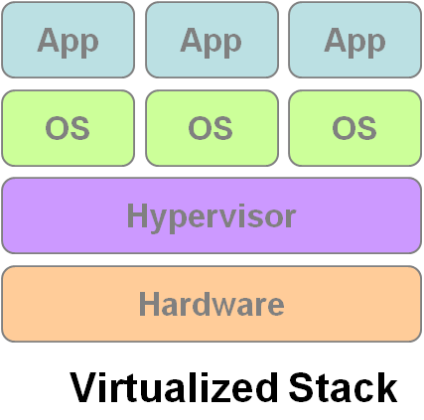
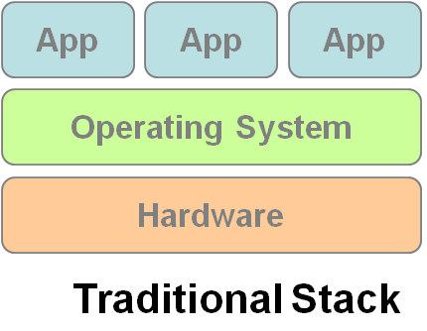
Hardware Virtualization
Cloud computing services are usually backed by large-scale data centers composed of thousands of computers.
Such data centers are built to serve many users and host many disparate applications.
For this purpose, hardware virtualization can be considered as a perfect fit to overcome most operational issues of data center building and maintenance.
Virtualization enhances :sharing and utilization of computer systems
VM1
VM2
VM3

Slide 27
Three basic capabilities regarding management of workload:
Workload isolation-A virtual machine should not be able to read RAM that is in use by another virtual machine. It also should not be able to access another virtual machine’s disk.
Workload migration - encapsulating guest OS system state within VM and allowing it to migrate or suspend etc.( facilitates h/w maintenance, load balancing and disaster recovery).
Workload consolidation – combining heterogenous workloads onto a single platform.

Slide 28
H/w virtualization allows running multiple OS and a s/w stacks on a single physical platform
VMM (virtual machine monitor) also called hypervisor mediates access to physical hardware presenting each guest OS a VM
A number of VMM platforms like VMWare, Xen…. that are the basis of many utility or cloud computing environments.
Benefits
Sharing and utilization
Better manageability
Higher reliability

Slide 29
Autonomic Computing
The increasing complexity of computing systems has motivated research on autonomic computing, which seeks to improve systems by decreasing human involvement in their operation.
In other words, systems should manage themselves, with high-level guidance from humans
Autonomic, or self-managing, systems rely on monitoring probes and gauges (sensors), on an adaptation engine (autonomic manager) for computing optimizations based on monitoring data, and on effectors to carry out changes on the system

Slide 30
The large data centers of cloud computing providers must be managed in an efficient way. In this sense, the concepts of autonomic computing inspire software technologies for data center automation, which may perform tasks such as:
→management of service levels of running applications; →management of data center capacity;
→proactive disaster recovery;
→automation of VM provisioning

Slide 31

Service Models
Choose the service you need.

Slide 32

A Simple Analogy
Say, you just moved to a city and you are looking for a place to live.

Slide 33

What is your choice ?
Build a new house ?
Buy an empty house ?
Live in a hotel ?

Slide 34
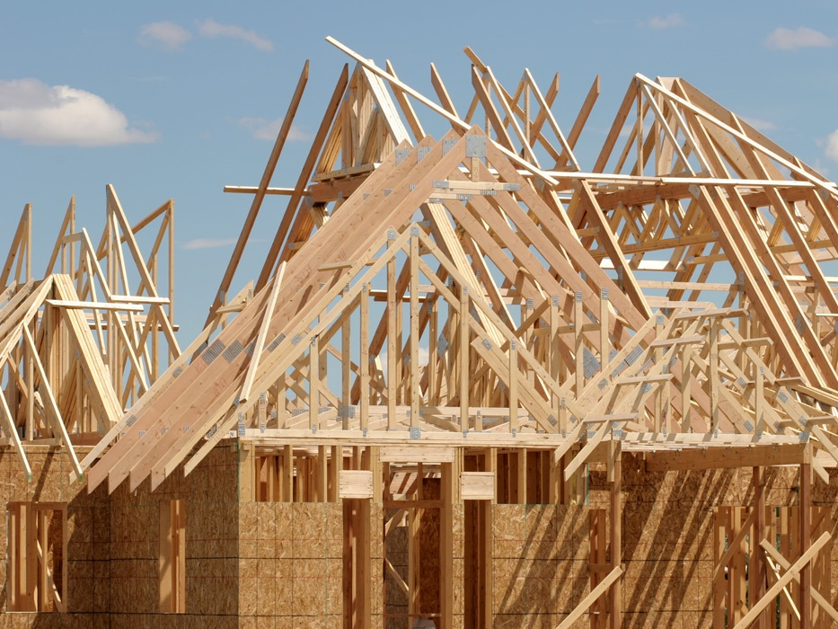
Let’s build a new house !!
You can fully control everything your like your new house to have. But that is a hard work …

Slide 35

If you buy an empty house ?
You can customize some part of your house. But never change the original architecture.

Slide 36

How about live in a hotel ?
Live in a hotel will be a good idea if the only thing you care is enjoy your life!! There is nothing you can do with the house except living in it.

Slide 37
Let’s translate to Cloud Computing !!

Slide 38
Service Models Overview
What if you want to have an IT department ?
Similar to build a new house in previous analogy
You can rent some virtualized infrastructure and build up your own IT system among those resources, which may be fully controlled.
Technical speaking, use the Infrastructure as a Service (IaaS) solution.
Similar to buy an empty house in previous analogy
You can directly develop your IT system through one cloud platform, and do not care about any lower level resource management.
Technical speaking, use the Platform as a Service (PaaS) solution.
Similar to live in a hotel in previous analogy
You can directly use some existed IT system solutions, which were provided by some cloud application service provider, without knowing any detail technique about how these service was achieved.
Technical speaking, use the Software as a Service (SaaS) solution.

Slide 39
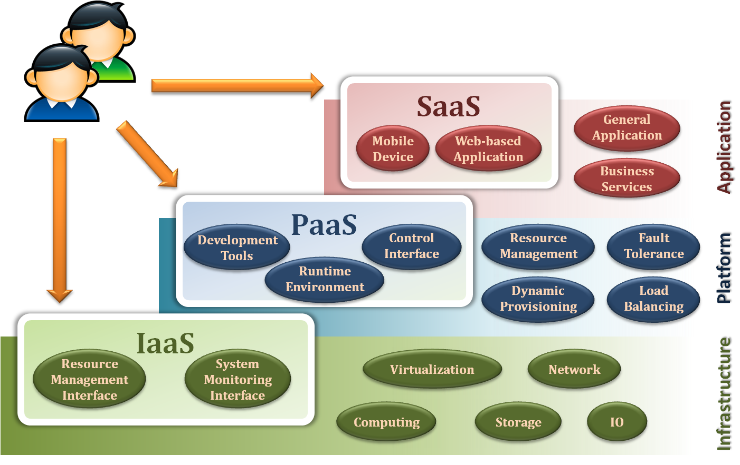
Service Model Overview

Slide 40
Continued…..
Infrastructure as a Service (IaaS): hardware is provided by an external provider and managed for the customers
Platform as a Service (PaaS): in addition to hardware, your operating system layer is managed …..
Software as a Service (SaaS): further to the above, an application layer is provided and managed for you

Slide 42
Service Models
Infrastructure as a Service
Platform as a Service
Software as a Service

Slide 43
Infrastructure as a Service
Infrastructure as a Service – IaaS
The capability provided to the consumer is to provision processing, storage, networks, and other fundamental computing resources where the consumer is able to deploy and run arbitrary software, which can include operating systems and applications.
The consumer does not manage or control the underlying cloud infrastructure but has control over operating systems and deployed applications, and possibly limited control of networking components .
The cloud computing service provider manages the infrastructure, - customer - install, configure and manage your own software like —operating systems, middleware and applications
Notes:
IaaS helps you avoid the expense and complexity of buying and managing your own physical servers and other datacenter infrastructure. Each resource is offered as a separate service component and you only need to rent a particular one for as long as you need it. The cloud computing service provider manages the infrastructure, while you purchase, install, configure and manage your own software—operating systems, middleware and applications.

Slide 44
Examples :
Amazon EC2 - Amazon Elastic Compute Cloud (EC2) - allowing users to rent virtual computers on which to run their own computer applications.
OpenNebula - OpenNebula is a cloud computing platform for managing heterogeneous distributed data center infrastructures
Amazon Web Services (AWS) and Google Cloud Platform (GCP) are examples of independent IaaS providers

Slide 45
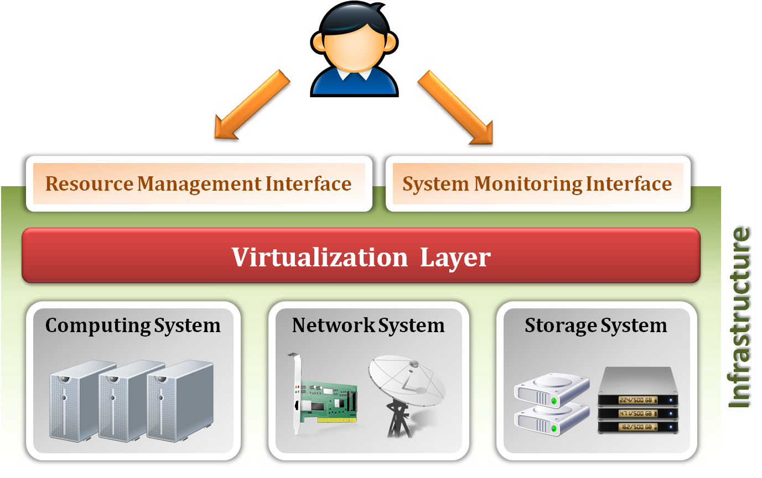
Infrastructure as a Service
System architecture :

Slide 46
Infrastructure as a Service
Enabling technique - Virtualization
Virtualization is an abstraction of logical resources away from underlying physical resources.
Virtualization technique shift OS onto hypervisor.
Multiple OS share the physical hardware and provide different services.
Improve utilization, availability, security and convenience.
VM1
VM2
VM3
Notes:
A hypervisor is a hardware virtualization technique that allows multiple guest operating systems (OS) to run on a single host system at the same time. The guest OS shares the hardware of the host computer, such that each OS appears to have its own processor, memory and other hardware resources.

Slide 47
Infrastructure as a Service
Website hosting. Running websites using IaaS can be less expensive than traditional web hosting.
Storage, backup and recovery-handles unpredictable demand and steadily growing storage needs and simplifies planning and management of backup and recovery systems.
Web apps. IaaS provides all the infrastructure to support web apps, including storage, web and application servers and networking resources
High-performance computing. High-performance computing (HPC) on supercomputers, computer grids or computer clusters helps solve complex problems involving millions of variables or calculations
Big data analysis. Big data is a popular term for massive data sets requires huge amount of processing power …which IaaS provides.
Notes:
Website hosting. Running websites using IaaS can be less expensive than traditional web hosting.
Storage, backup and recovery. Organisations avoid the capital outlay for storage and complexity of storage management, which typically requires a skilled staff to manage data and meet legal and compliance requirements. IaaS is useful for handling unpredictable demand and steadily growing storage needs. It can also simplify planning and management of backup and recovery systems.
Web apps. IaaS provides all the infrastructure to support web apps, including storage, web and application servers and networking resources. Organisations can quickly deploy web apps on IaaS and easily scale infrastructure up and down when demand for the apps is unpredictable.
High-performance computing. High-performance computing (HPC) on supercomputers, computer grids or computer clusters helps solve complex problems involving millions of variables or calculations. Examples include earthquake and protein folding simulations, climate and weather predictions, financial modeling and evaluating product designs.
Big data analysis. Big data is a popular term for massive data sets that contain potentially valuable patterns, trends and associations. Mining data sets to locate or tease out these hidden patterns requires a huge amount of processing power, which IaaS economically provides.

Slide 48
Infrastructure as a Service
Provide service –Resource Management Interface
Several types of virtualized resource provided by IaaS :
Virtual Machine –provides the basic virtual machine operations, such as creation, suspension, resumption and termination, …etc.
Virtual Storage – provides the basic virtual storage operations, such as space allocation, space release, data writing and data reading, …etc.
Virtual Network –provides the basic virtual network operations, such as IP address allocation, domain name register, connection establishment and bandwidth provision, …etc.
Notes:
IaaS: Infrastructure as a Service Cloud infrastructure services, known as “Infrastructure as a Service” (IaaS), deliver computer infrastructure (such as a platform virtualization environment), storage, and networking. Instead of having to purchase software, servers, or network equipment, users can buy these as a fully outsourced service that is usually billed according to the amount of resources consumed. Basically, in exchange for a rental fee, a third party allows you to install a virtual server on their IT infrastructure. Compared to SaaS and PaaS, IaaS users are responsible for managing more: applications, data, runtime, middleware, and O/S. Vendors still manage virtualization, servers, hard drives, storage, and networking. What users gain with IaaS is infrastructure on top of which they can install any required platforms. Users are responsible for updating these if new versions are released.

Slide 49
Infrastructure as a Service
Provide service – System Monitoring Interface
Several types of monitoring metrics :
Virtual Machine - monitor some system states of each virtual machine, such as CPU loading, memory utilization, IO loading and internal network loading, …etc.
Virtual Storage –monitor some storage states of each virtual storage, such as virtual space utilization, data duplication and storage device access bandwidth, …etc.
Virtual Network –monitor some network states of each virtual network, such as virtual network bandwidth, network connectivity and network load balancing, …etc.
Notes:
IaaS (Infrastructure as a Service), as the name suggests, provides you the computing infrastructure, physical or (quite often) virtual machines and other resources like virtual-machine disk image library, block and file-based storage, firewalls, load balancers, IP addresses, virtual local area networks etc.
Examples: Amazon EC2, Windows Azure, Rackspace, Google Compute Engine.

Slide 50
Service Models
Infrastructure as a Service
Platform as a Service
Software as a Service

Slide 51
Platform as a Service
Platform as a Service - PaaS
The consumer does not manage or control the underlying cloud infrastructure including network, servers, operating systems, or storage, but has control over the deployed applications.
Apart from servers, storage and networking—it also includes middleware, development tools, business intelligence (BI) services, database management systems and more…
Can avoid the expense and complexity of buying software licenses, and managing the underlying application infrastructure and middleware or the development tools and other resources

Slide 52
Examples :
Microsoft Windows Azure - Microsoft Azure is a growing collection of cloud services for building, deploying and managing applications through global network of datacentres.
Google App Engine- Google App Engine is a fully managed platform that completely abstracts away infrastructure so user can focus only on code.
Hadoop- Hadoop is an open source, Java-based programming framework that supports the processing and storage of extremely large data sets in a distributed computing environment.

Slide 53
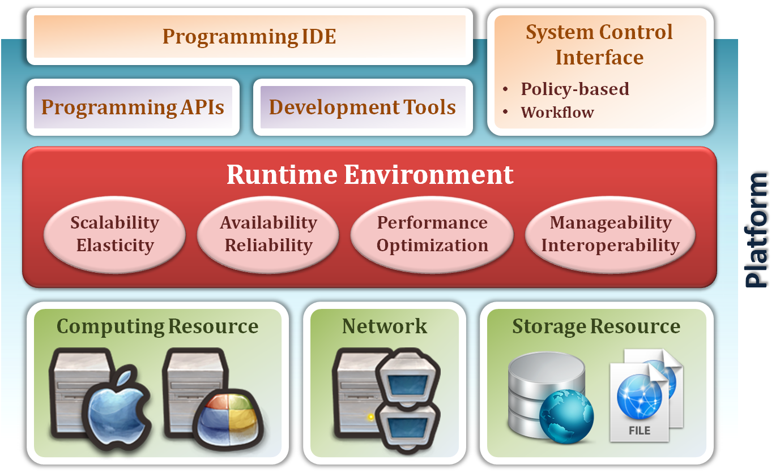
Platform as a Service
System architecture :
Notes:
PaaS allows you to avoid the expense and complexity of buying and managing software licenses, the underlying application infrastructure and middleware or the development tools and other resources
PAAS (Platform as a Service) is more popular among developers as they can put all their concentration on developing their apps and leave the rest of management and execution to the service provider. Many service providers also offer the flexibility to increase/decrease the CPU power depending upon the traffic loads giving developers cost effective and easy & effortless management.

Slide 54
PAAS (Platform As A Service) :
A layer on top of IAAS
Runtimes (like java runtimes), Databases (like mySql, Oracle), Web Servers (tomcat etc)
Provides you computing platforms which typically includes operating system, programming language execution environment, database, web server etc.
Many service providers also offer the flexibility to increase/decrease the CPU power depending upon the traffic loads giving developers cost effective and easy & effortless management.

Slide 55
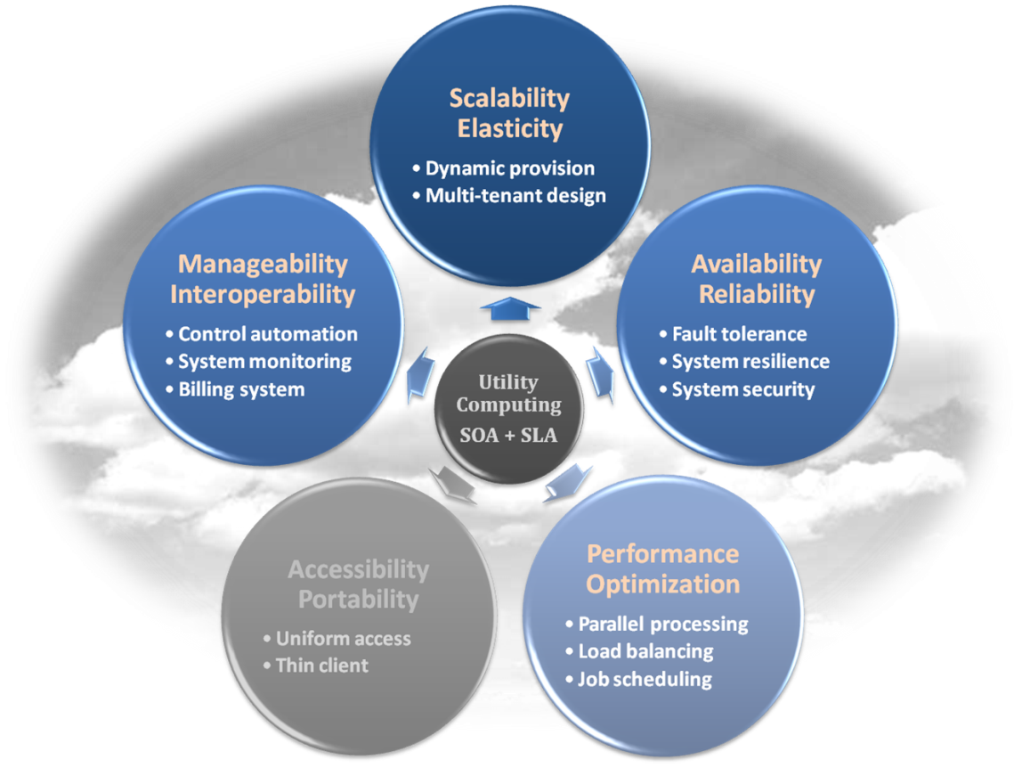
Platform as a Service
Enabling technique – Runtime Environment Design
Runtime environment refers to collection of software services available. Usually implemented by a collection of program libraries.
Common properties in Runtime Environment :
Manageability and Interoperability
Performance and Optimization
Availability and Reliability
Scalability and Elasticity

Slide 56
Platform as a Service
Provide service – Programming IDE
Users make use of programming IDE to develop their service among PaaS.
This IDE should integrate the full functionalities which supported from the underling runtime environment.
This IDE should also provide some development tools, such as profiler, debugger and testing environment.
Notes:
PaaS: Platform as a Service The most complex of the three, cloud platform services or “Platform as a Service” (PaaS) deliver computational resources through a platform. What developers gain with PaaS is a framework they can build upon to develop or customize applications. PaaS makes the development, testing, and deployment of applications quick, simple, and cost-effective, eliminating the need to buy the underlying layers of hardware and software. One comparison between SaaS vs. PaaS has to do with what aspects must be managed by users, rather than providers: With PaaS, vendors still manage runtime, middleware, O/S, virtualization, servers, storage, and networking, but users manage applications and data.

Slide 57
Platform as a Service
Provide service – System Control Interface
Policy-Based Control
rule to guide decisions and achieve rational outcome(s)
Make the decision according to some requirements
Workflow Control
Describe the flow of installation and configuration of resources
delivers speedy and efficient construction
management of cloud resources

Slide 58
Service Models
Infrastructure as a Service
Platform as a Service
Software as a Service

Slide 59
Software as a Service
A layer on top on PAAS
The capability provided to the consumer is to use the provider’s applications running on a cloud infrastructure. The applications are accessible from various client devices through a thin client interface such as a web browser (e.g., web-based email).
Often referred to as "on-demand software".
Don’t want to worry about the installation, setup and running of the application. Service provider will do that.
Notes:
SaaS: Software as a Service Cloud application services or “Software as a Service” (SaaS) are probably the most popular form of cloud computing and are easy to use. SaaS uses the Web to deliver applications that are managed by a third-party vendor and whose interface is accessed on the clients’ side. Most SaaS applications can be run directly from a Web browser, without any downloads or installations required. SaaS eliminates the need to install and run applications on individual computers. With SaaS, it’s easy for enterprises to streamline their maintenance and support, because everything can be managed by vendors: applications, runtime, data, middleware, O/S, virtualization, servers, storage, and networking. Gmail is one famous example of an SaaS mail provider.

Slide 60
Examples :
Google Apps (e.g., Gmail, Google Docs, Google sites, …etc)
Google Apps, Microsoft Office 365.
Applications like email (Gmail, Yahoo mail etc), Social Networking sites (Facebook etc)

Slide 61
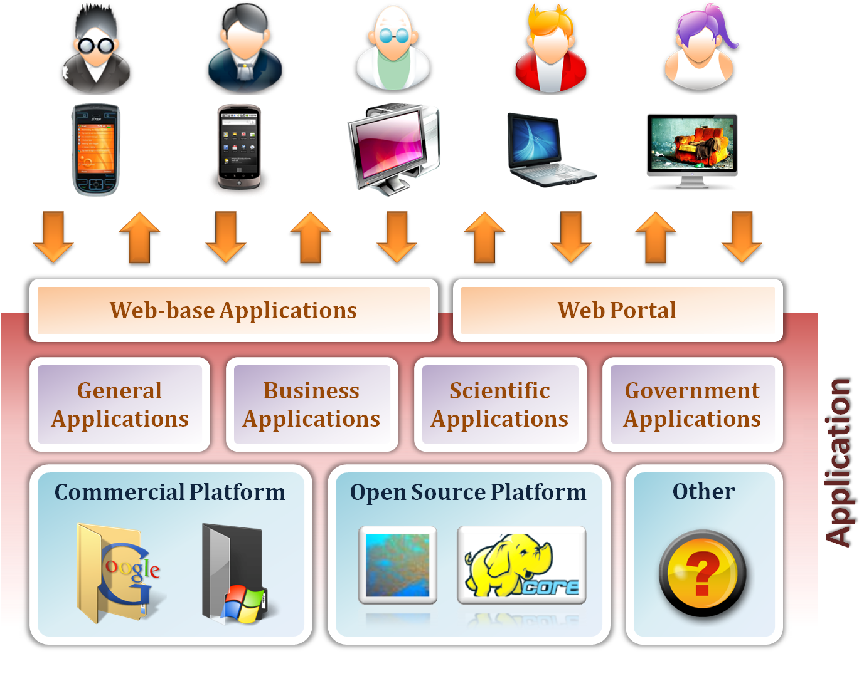
Software as a Service

Slide 62
Software as a Service
Enabling Technique – Web Service
Web 2.0 is the trend of using the full potential of the web
Viewing the Internet as a computing platform
Running interactive applications through a web browser
Leveraging interconnectivity and mobility of devices
Enhanced effectiveness with greater human participation
Properties provided by Internet :
Accessibility and Portability

Slide 63
Software as a Service
Provide service – Web-based Applications
Conventional applications should translate their access interface onto web-based platform.
Applications in different domains
General Applications –s office suit, multimedia and instant message,
Business Applications –ERP (Enterprise Resource Plan), CRM (Customer Relationship Management)and market trading system
Scientific Applications –aerospace simulation and biochemistry simulation, …etc.
Government Applications national medical system and public transportation system service, …etc.

Slide 64
Software as a Service
Provide service – Web Portal
standard search engine feature,
web portals offer other services such as e-mail, news, stock prices, information, databases and entertainment.
Some examples :
iGoogle - personal web portal
MSNBC - American news cable and satellite television network
Netvibes - track clients, customers and competitors across media sources all in one place, analyze live results ...
Yahoo! - Yahoo! is a web services provider

Slide 65

Deployment models
How to deploy a cloud system ?

Slide 66
Deployment Model
There are four primary cloud deployment models :
Public Cloud
Private Cloud
Community Cloud
Hybrid Cloud
Each can exhibit the previously discussed characteristics; their differences lie primarily in the scope and access of published cloud services, as they are made available to service consumers.

Slide 67
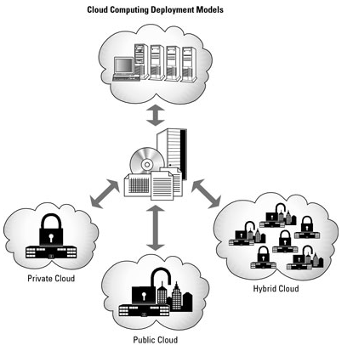
Deployment Models

Slide 68
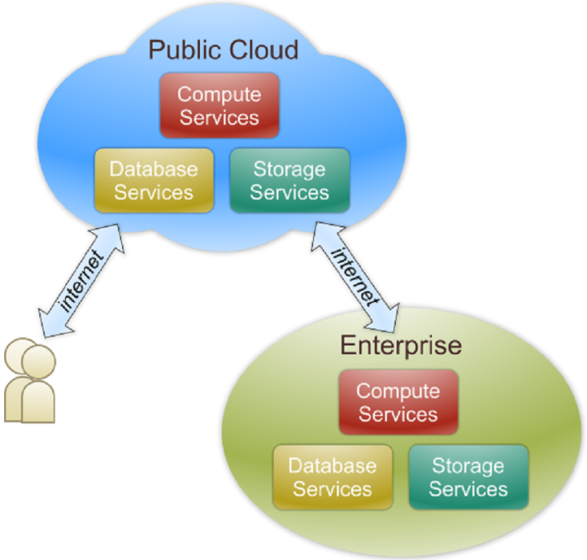
Public Cloud
Public cloud definition
The cloud infrastructure is made available to the general public or a large industry group and is owned by an organization selling cloud services.
Also known as external cloud or multi-tenant cloud, this model essentially represents a cloud environment that is openly accessible.
Basic characteristics :
Homogeneous infrastructure
Common policies
Shared resources and multi-tenant
Leased or rented infrastructure
Economies of scale - because infrastructure costs are spread across all users, thus allowing each individual client to operate on a low-cost

Slide 69
Examples of public clouds include
ESDS’s eNlight Cloud,
Amazon Elastic Compute Cloud (EC2),
IBM’s Blue Cloud,
Sun Cloud,
Google AppEngine and
Windows Azure Services Platform.
Most of the google services
Google Doc, Spreadsheet
A public cloud is one based on the standard cloud computing model, in which a service provider makes resources, such as virtual machines (VMs), applications or storage, available to the general public over the internet. Public cloud services may be free or offered on a pay-per-usage model.
Notes:
Public cloud solutions are readily available from Google, Amazon, Microsoft, and others. Public cloud services provide infrastructure and services to the public, and you, or your organization, secure a piece of that infrastructure and network. Resources are shared by hundreds or thousands of people. Gmail and U of I Box are examples of public cloud services. Google reported in April 2017 that it had 1 billion monthly users. While your email account is protected by a password, the hardware on which it is stored is shared by over 1 billion people.

Slide 70
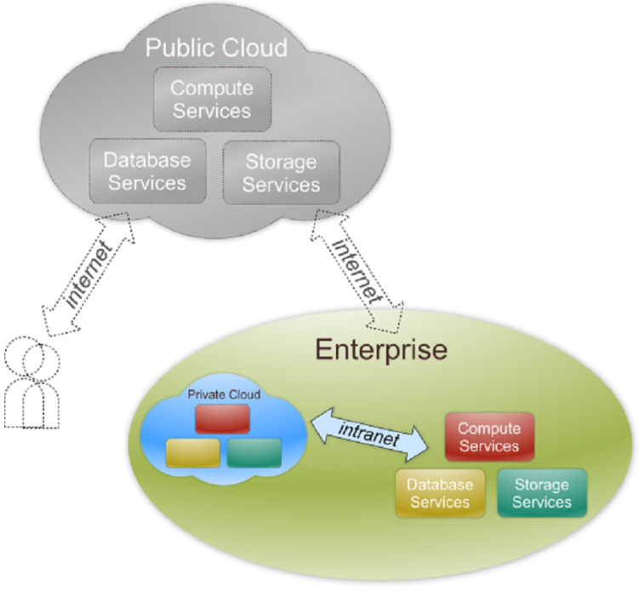
Private Cloud
Private cloud definition
The cloud infrastructure is operated solely for an organization. It may be managed by the organization or a third party and may exist on premise or off premise.
Also referred to as internal cloud or on-premise cloud, a private cloud intentionally limits access to its resources to service consumers that belong to the same organization that owns the cloud.
Basic characteristics :
Heterogeneous infrastructure
Customized and tailored policies
Dedicated resources
In-house infrastructure
End-to-end control
Notes:
Private cloud solutions are dedicated to one organization or business, and often have much more specific security controls than does a public cloud. Many medical offices, banking institutions and other organizations who are required to meet federal and state guidelines for data controls use a private cloud. Using private cloud storage allows them to control highly sensitive data by meeting regulations and industry-based criteria, whether that be medical records, trade secrets, or other classified information. Private cloud solutions utilize infrastructure that is either owned and controlled by the organization, or they are able to contractually require those specific criteria be met by a vendor who manages the infrastructure.

Slide 71
Private cloud storage allows them to control highly sensitive data by meeting regulations and industry-based criteria, whether that be medical records, trade secrets, or other classified information

Slide 72
Public vs. Private
Comparison :
 | Public Cloud | Private Cloud
Infrastructure | Homogeneous | Heterogeneous
Policy Model | Common defined | Customized & Tailored
Resource Model | Shared & Multi-tenant | Dedicated
Cost Model | Operational expenditure | Capital expenditure
Economy Model | Large economy of scale | End-to-end control
A homogeneous cloud is one where the entire software stack, from the hypervisor through various intermediate management layers, all the way to the end-user portal, is provided by one vendor.
A heterogeneous cloud, on the other hand, integrates components by many different vendors, either at different levels or even at the same level.

Slide 73
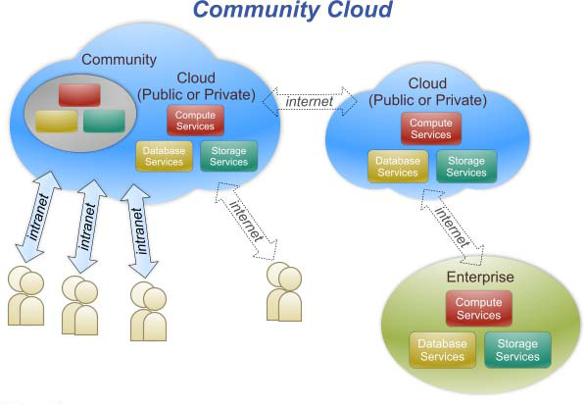
Community Cloud
Community cloud definition
The cloud infrastructure is shared by several organizations and supports a specific community that has shared concerns (e.g., mission, security requirements, policy, and compliance considerations).
Community clouds are often designed for businesses and organizations working on joint projects, applications, or research, which requires a central cloud computing facility for building, managing and executing such projects.

Slide 74
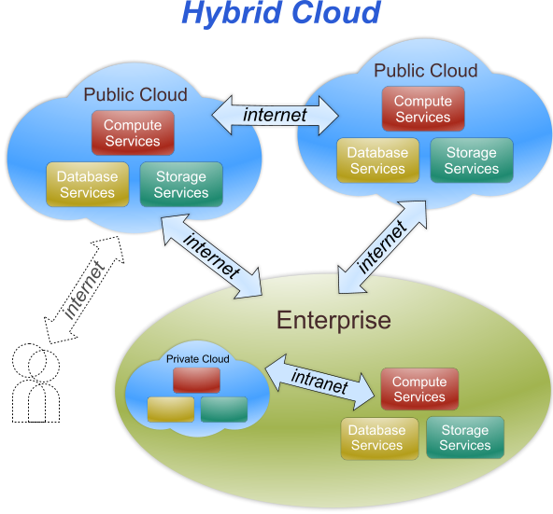
Hybrid Cloud
Hybrid cloud definition
The cloud infrastructure is a composition of two or more clouds (private, community, or public) that remain unique entities but are bound together by standardized or proprietary technology that enables data and application portability (e.g., cloud bursting for load-balancing between clouds).
An example of a hybrid cloud solution is an organization that wants to keep confidential information secured on their private cloud, but make more general, customer-facing content on a public cloud.
Cloud bursting is an application deployment model in which an application runs in a private cloud and burst into a public cloud when the demand for computing capacity spikes.
Notes:
Hybrid cloud solutions are a blend of public and private clouds. This is a more complex cloud solution in that the organization must manage multiple platforms and determine where data is stored. An example of a hybrid cloud solution is an organization that wants to keep confidential information secured on their private cloud, but make more general, customer-facing content on a public cloud.

Slide 75
For example, an enterprise can deploy an on-premises private cloud to host sensitive or critical workloads, but use a third-party public cloud provider, such as Google Compute Engine, to host less-critical resources, such as test and development workloads. To hold customer-facing archival and backup data, a hybrid cloud could also use Amazon Simple Storage Service (Amazon S3). A software layer, such as Eucalyptus, can facilitate private cloud connections to public clouds.Eg. AWS

Slide 76
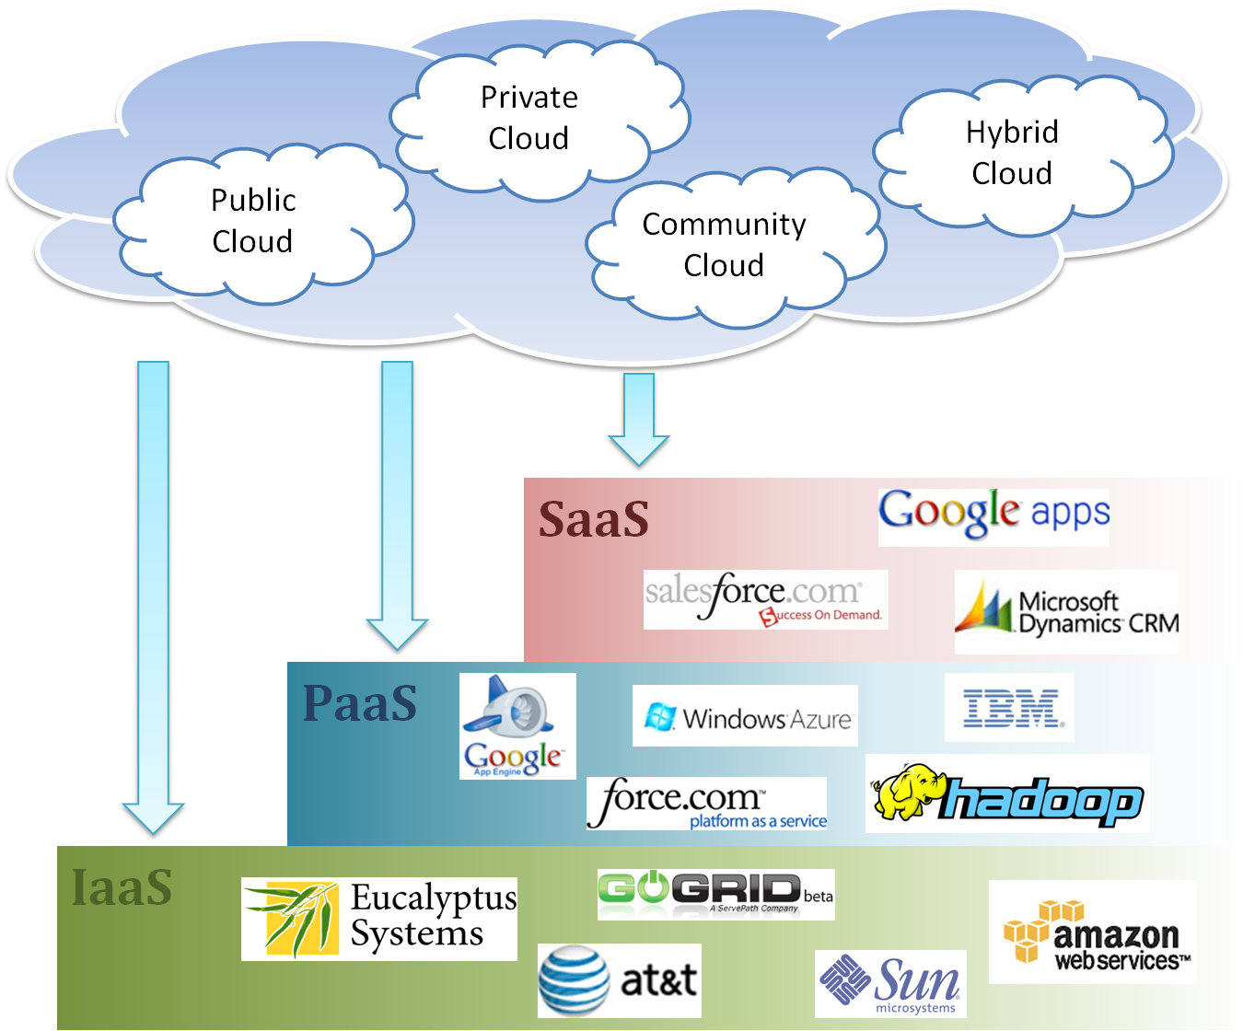
Cloud Ecosystem

Slide 77
Features of Cloud
Self Service
Per usage metering and billing
Elasticity
customization

Slide 78
Self-Service
Consumers of cloud computing services expect on-demand
Nearly instant access to resources
Clouds must allow self-service access
Customers can request, customize, pay, and use services without intervention of human operators
Notes:
1.4.1 Self-Service

Slide 79
Per-Usage Metering and Billing
Cloud computing eliminates up-front commitment by users
Allowing them to request and use only the necessary amount
Services must be priced on a short-term basis, e.g., by the hour
Allowing users to release (and not pay for) resources as soon as they are not needed
Clouds must allow efficient trading of service
Such as pricing, accounting, and billing
Notes:
1.4.2 Per-Usage Metering and Billing

Slide 80
Per-Usage Metering and Billing
Metering should be done accordingly for different types of service
e.g., storage, processing, and bandwidth
Usage is promptly reported
Thus providing greater transparency
Notes:
1.4.2 Per-Usage Metering and Billing

Slide 81
Elasticity
Cloud computing gives the illusion of infinite computing resources available on demand
Users expect clouds to rapidly provide resources in any quantity at any time
The additional resources can be
Provisioned, possibly automatically, when an application load increases
Released when load decreases
Scale up and down
Notes:
1.4.3 Elasticity

Slide 82
Customization
A multi-tenant cloud often reveals a great disparity between user needs
Resources rented from the cloud must be highly customizable
Infrastructure services allow users
To deploy specialized virtual appliances
To be given privileged (root) access to the virtual servers
PaaS and SaaS offer less flexibility
Not suitable for general-purpose computing
Still expected to provide a certain level of customization
Notes:
1.4.4 Customization

Slide 83
Cloud Infrastructure Management
Features available in Virtual Infrastructure Manager(VIM):
Virtualization Support
Self Service, On Demand Resource Provisioning
Multiple backend hypervisors
Storage Virtualization
Interface to public clouds
Virtual Networking
Dynamic Resource allocation
Virtual Clusters
Reservation and negotiation mechanism
High availability and Data Recovery

Slide 84
Features
Virtualization Support
The multi-tenancy aspect of clouds requires multiple customers with disparate requirements to be served by a single hardware infrastructure
Virtualized resources (CPUs, memory, etc.) Can be sized and resized with certain flexibility
Hardware virtualization
The ideal technology to create a virtual infrastructure that partitions a data center among multiple tenants
Notes:
1.5.1 Features

Slide 85
Features (cont.)
Self-Service, On-Demand Resource Provisioning
Enables users to directly obtain services from clouds
e.g., spawning the creation of a server
Tailoring its software, configurations, and security policies
Without interacting with a human system administrator
Eliminates the need for more time-consuming, labor-intensive, human-driven procurement processes familiar to many in IT
Users can easily interact with the system
Notes:
1.5.1 Features

Slide 86
Features (cont.)
Multiple Backend Hypervisors
Some VI managers provide a uniform management layer
regardless of the virtualization technology used
Usually provide pluggable drivers to interact with multiple hypervisors
Notes:
1.5.1 Features

Slide 87
Features (cont.)
Storage Virtualization
Abstracting logical storage from physical storage
Consolidating all available storage devices in a data center to create virtual disks independent from device and location
Storage devices are commonly organized in a storage area network (SAN) attached to servers
Via protocols such as Fibre Channel, ISCSI, and NFS
A storage controller provides the layer of abstraction between virtual and physical storage
Notes:
1.5.1 Features

Slide 88
Features (cont.)
Interface to Public Clouds
Extends the capacity by borrowing resources from public clouds
Make good use of the available resources
In case of spikes in demand, extra load can be offloaded to rented resources
A VI manager can be used in a hybrid cloud setup
Offers a driver to manage the life cycle of virtualized resources obtained from external cloud providers
Must ideally be transparent
Notes:
1.5.1 Features

Slide 89
Features (cont.)
Virtual Networking
Virtual networks allow creating an isolated network on top of a physical infrastructure
independently from physical topology and locations
A virtual LAN (VLAN) allows isolating traffic that shares a switched network
Allowing VMs to be grouped into the same broadcast domain
Can be configured to block traffic originated from VMs from other networks
The VPN (virtual private network) concept is a secure and private overlay network on top of a public network
Most commonly the public Internet
VI managers support creating and configuring virtual networks to group VMs placed throughout a data center
Notes:
1.5.1 Features

Slide 90
Features (cont.)
Dynamic Resource Allocation
Increased awareness of energy consumption in data centers has encouraged dynamic consolidating VMs in a fewer number of servers
Applications have variable and dynamic needs
Also reallocates available resources among VMs according to application needs
Energy consumption reduction and better management of SLAs can be achieved
By dynamically remapping VMs to physical machines at regular intervals
Machines that are not assigned any VM can be turned off or put on a low power state
Notes:
1.5.1 Features

Slide 91
Features (cont.)
Virtual Clusters
Several VI managers can holistically manage groups of VMs
Useful for provisioning computing virtual clusters on demand
Interconnecting VMs for multi-tier Internet applications
Notes:
1.5.1 Features

Slide 92
Features (cont.)
Reservation and Negotiation Mechanism
Requests are termed advance reservations (AR)
Users request computational resources to be available at a specific time
In contrast to best-effort requests
Users request resources whenever available
The provider can offer a distinct slot that is still satisfactory to the user
OpenPEX incorporates a bilateral negotiation protocol
Allows users and providers to come to an alternative agreement by exchanging offers and counter offers
Notes:
1.5.1 Features

Slide 93
Features (cont.)
High Availability (HA) and Data Recovery
High availability feature minimizing application downtime and preventing business disruption
Providing a failover mechanism
Detects failure of both physical and virtual servers and restarts VMs on healthy physical servers
Protects failures from host
Frequent backup of a large number of VMs should be done with minimal interference in the systems performance
Each one is attached with multiple virtual disks
Notes:
1.5.1 Features

Slide 94
IaaS Features:
Geographic presence
User Interface and access to users
Advance reservation of capacity
Automatic Scaling and Load Balancing
Service level Agreement
Hypervisor and OS choice

Slide 95
Features (cont.)
Geographic Presence
A provider of worldwide services would typically build several data centers distributed around the world
To improve availability and responsiveness
Notes:
1.6.1 Features

Slide 96
Features (cont.)
User Interfaces and Access to Servers
A public IaaS provider must provide multiple access means to its cloud
For various users and their preferences
Different types of user interfaces (UI) provide different levels of abstraction
The most common being graphical user interfaces (GUI), command-line tools (CLI), and Web service (WS) APIs
GUIs are preferred by end users who need to launch, customize, and monitor a few virtual servers
Do not necessary need to repeat the process several times
WS APIs offer programmatic access to a cloud using standard HTTP requests
Allowing complex services to be built on top of IaaS clouds
Notes:
1.6.1 Features

Slide 97
Features (cont.)
Advance Reservation of Capacity
Allow users to reserve resources for a specific time frame in the future
Cloud resources will be available at that time
Most clouds only support best-effort requests
Users requests are served whenever resources are available
Amazon Reserved Instances is a form of advance reservation of capacity
Allowing users to pay a fixed amount of money in advance to guarantee resource availability at anytime during an agreed period
Then paying a discounted hourly rate when resources are in use
Only long periods of 1 to 3 years are offered
Users cannot express their reservations in finer granularities, e.g., hours or days
Notes:
1.6.1 Features

Slide 98
Features (cont.)
Automatic Scaling and Load Balancing
Elasticity is a key characteristic of the cloud
Applications often need to scale up and down to meet varying load conditions
Automatic scaling is a highly desirable feature of IaaS clouds
Allow users to set conditions for when they want their applications to scale up and down
Based on application-specific metrics such as transactions per second, number of simultaneous users, request latency, etc.
Incoming traffic must be automatically distributed among the available servers
Enables applications to promptly respond to traffic increase while also achieving greater fault tolerance
Notes:
1.6.1 Features

Slide 99
Features (cont.)
Service-Level Agreement
Offered by IaaS providers to express their commitment to delivery of a certain QoS
To customers it serves as a warranty
Include availability and performance guarantees
Metrics must be agreed upon by all parties as well as penalties for violating these expectations
Notes:
1.6.1 Features

Slide 100
PaaS Features:
Programming Models, Languages and Frameworks – how user can express their application and how efficiently they run in cloud platform.
Persistence Options – to record their states and recover in case of crashes

Slide 101
Features
Programming Models, Languages, and Frameworks
Programming models made available by IaaS providers
Define how users can express their applications using higher levels of abstraction and efficiently run them on the cloud platform
The most common activities that require specialized models are
MapReduce model: Processing of large dataset in clusters of computers
Development of request-based Web services and applications
High-performance distributed execution of various computational tasks
PaaS providers usually support multiple programming languages
Python and Java (e.g., Google appengine)
.NET languages (e.g., Microsoft Azure)
Ruby (e.g., Heroku)
Notes:
1.7.1 Features

Slide 102
Features (cont.)
Persistence Options
A persistence layer is essential to allow applications to record their state
Recover it in case of crashes
Also store user data
Web and enterprise application developers have chosen relational databases as the preferred persistence method
Offer fast and reliable structured data storage and transaction processing
May lack scalability to handle several petabytes (2⁵⁰) of data stored in commodity computers
Distributed storage technologies have emerged
Seek to be robust and highly scalable
At the expense of relational structure and convenient query languages
Notes:
1.7.1 Features

Slide 103
Challenges and Risk:
Security , Privacy and Trust
Data Lock in and standardization
Availability , Fault Tolerance and Disaster Recovery
Resource Management and Energy

Slide 104
Challenges And Risks
A signiﬁcant number of challenges and risks are inherent to cloud computing
User privacy, data security
Availability of service, disaster recovery
Performance, scalability, energy-efﬁciency
Programmability
Notes:
1.8 Challenges And Risks

Slide 105
Security, Privacy, and Trust
Information security is a main issue
Current cloud offerings are essentially public
Exposing the system to more attacks
Need to make cloud computing environments as secure as in-house IT systems
e.g., data encryption, VLANs, and ﬁrewalls
The trust toward providers is fundamental
To ensure the desired level of privacy for applications hosted in the cloud
Notes:
1.8.1 Security, Privacy, and Trust

Slide 106
Security, Privacy, and Trust (cont.)
Legal and regulatory issues also need attention
Providers may choose to locate data anywhere
The physical location of data centers determines the set of laws applied to the management of data
Speciﬁc cryptography techniques can not be used
They are not allowed in some countries
Country laws can impose that sensitive data are to be stored within national borders
e.g., patient health records
Notes:
1.8.1 Security, Privacy, and Trust

Slide 107
Data Lock-In and Standardization
A major concern of cloud computing users
Having their data locked-in by a certain provider
Users may want to move data and applications out from a provider that does not meet their requirements
Cloud computing infrastructures and platforms do not employ standard methods of storing user data and applications.
User data are not portable
Notes:
1.8.2 Data Lock-In and Standardization

Slide 108
Data Lock-In and Standardization (cont.)
Open Virtual Format (OVF)
OVF is a specification that describes an open-standard, secure, efficient, portable and extensible format for packaging and distributing software for virtual machines.
Hardware virtualization
Aims at facilitating packing and distribution of software to be run on VMs
Virtual appliances can be made portable
Seamlessly run on hypervisor of different vendors
The OVF standard is independent of any particular hypervisor or processor architecture.
Notes:
1.8.2 Data Lock-In and Standardization

Slide 109
Availability, Fault-Tolerance, and Disaster Recovery
Users will have certain expectations about the service level to be provided
Once their applications are moved to the cloud
Availability of the service, its overall performance
What measures are to be taken when something goes wrong in the system or its components
Users seek for a warranty before they can comfortably move their business to the cloud
SLAs must be ideally set up between customers and cloud computing providers
To act as warranty
Notes:
1.8.3 Availability, Fault-Tolerance, and Disaster Recovery

Slide 110
Availability, Fault-Tolerance, and Disaster Recovery (cont.)
Including QoS requirements
Speciﬁes the details of the service to be provided
Including availability and performance guarantees
Metrics must be agreed upon by all parties
Penalties for violating the expectations must also be approved
Notes:
1.8.3 Availability, Fault-Tolerance, and Disaster Recovery

Slide 111
Resource Management and Energy-Efﬁciency
One important challenge is the efﬁcient management of virtualized resource pools
Physical resources like CPU cores, disk space, and network bandwidth must be sliced and shared among virtual machines
Running potentially heterogeneous workloads
Dimensions to be considered include
Number of CPUs, amount of memory, size of virtual disks, and network bandwidth
Notes:
1.8.4 Resource Management and Energy-Efﬁciency

Slide 112
Resource Management and Energy-Efﬁciency (cont.)
Data centers consume large amounts of electricity
100 server racks can consume 1.3 MW of power
Another 1.3 MW are required by the cooling system
Costing USD 2.6 million per year
Data centers signiﬁcantly impact the environment
In terms of CO2 emissions from the cooling systems
Notes:
1.8.4 Resource Management and Energy-Efﬁciency

Slide 113
Resource Management and Energy-Efﬁciency (cont.)
Dynamic resource management can also improve utilization
Minimize energy consumption in data centers
By judiciously consolidating workload onto smaller number of servers
Turning off idle resources
Notes:
1.8.4 Resource Management and Energy-Efﬁciency

Slide 114
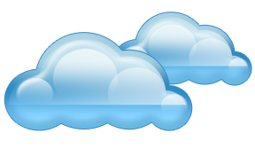
What is Cloud computing ?
Just for reference
Extra Material
Properties and characteristics

Slide 115
Properties and Characteristics
Cloud computing is a paradigm of computing, a new way of thinking about IT industry but not any specific technology.
Central ideas
Utility Computing
SOA - Service Oriented Architecture
SLA - Service Level Agreement
Properties and characteristics
High scalability and elasticity
High availability and reliability
High manageability and interoperability
High accessibility and portability
High performance and optimization
Enabling techniques
Hardware virtualization
Parallelized and distributed computing
Web service

Slide 116
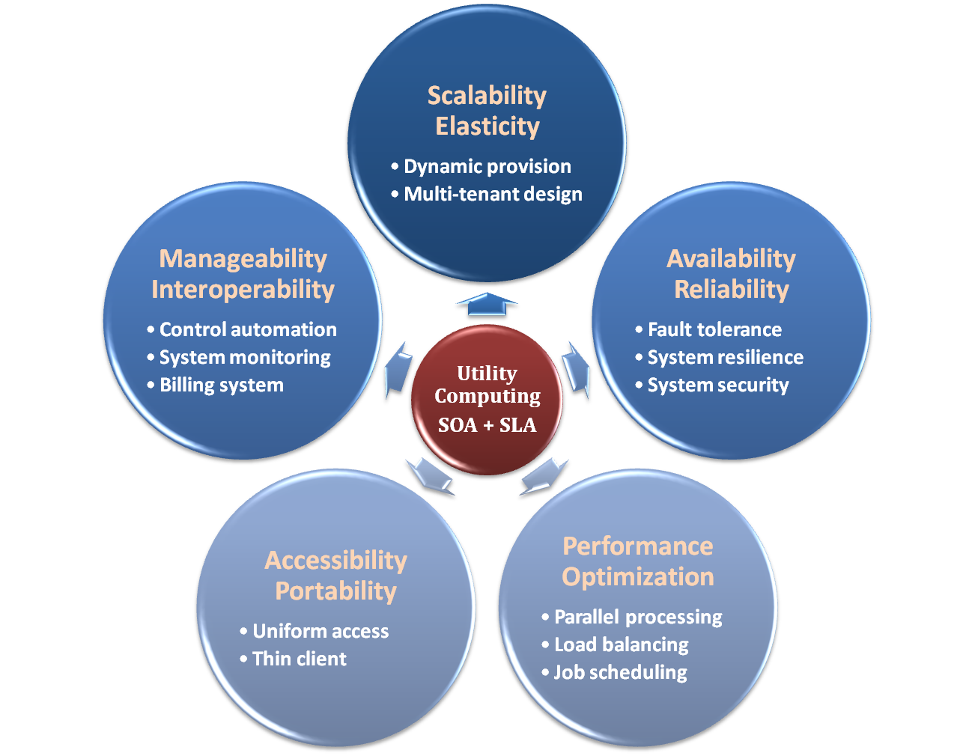

Properties and Characteristics

Slide 117

Central Ideas
Utility Computing SOA + SLA
Perspective from user :
Users do not care about how the works are done
Instead, they only concern about what they can get
Users do not care about what the provider actually did
Instead, they only concern about their quality of service
Users do not want to own the physical infrastructure
Instead, they only want to pay as many as they used
What dose user really care ?
They only care about their “Service”

Slide 118
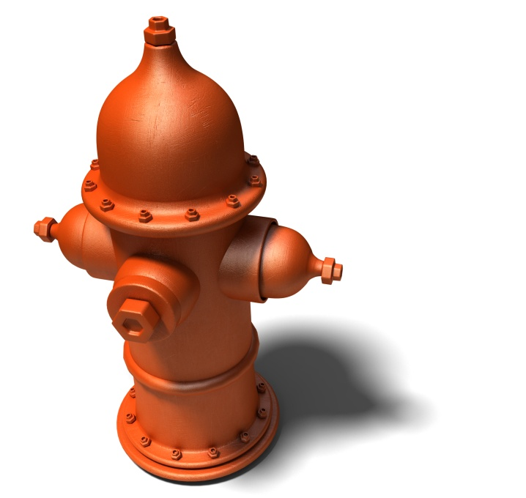
Utility Computing
Utility Computing SOA + SLA
One service provisioning model
Service provider makes computing resources and infrastructure management available to the customer as needed, and charges them for specific usage rather than a flat rate.
Like other types of on-demand computing , the utility model seeks to maximize the efficient use of resources and/or minimize associated costs.

Slide 119
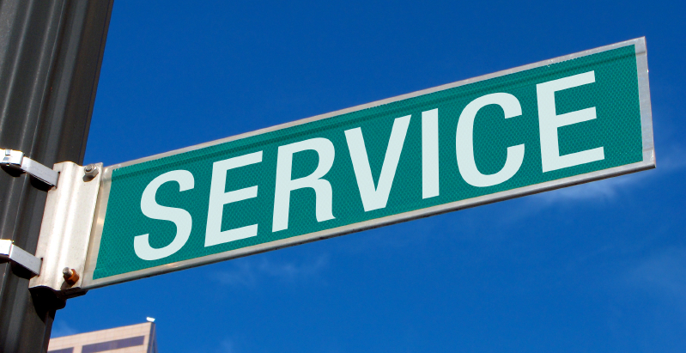
What Is Service?
Utility Computing SOA + SLA
Service is what you connect together using Web Services.
Service is the endpoint of a connection.
Functionalities of service :
A service should be well-defined
A service should be self-contained
A service should not depend on the context or state of other services.

Slide 120
What Is Web Service?
Utility Computing SOA + SLA
Definition :
Web service is self-describing and stateless modules that perform discrete units of work and are available over the network
Web Services Description Language (WSDL) :
Expressed in XML which include both data type and messages
Four types of operations :
One-way - Messages sent without a reply required
Request & response - Sending and replying messages
Solicit response - A request for a response
Notification - Messages sent to multiple receivers

Slide 121
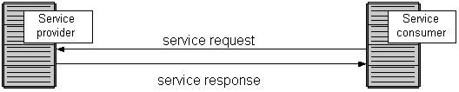
Service Oriented Architecture
Utility Computing SOA + SLA
Definition
Service Oriented Architecture (SOA) is essentially a collection of services which communicate with each other
Contain a flexible set of design principles used during the phases of systems development and integration
Provide a loosely-integrated suite of services that can be used within multiple business domains
Approach
Usually implemented by Web Service model

Slide 122

Quality Of Service
Utility Computing SOA + SLA
Original definition
Quality of Service (QoS) is a set of technologies for managing network traffic in a cost effective manner to enhance user experiences for home and enterprise environments.
Now QoS becomes to a broad term that is used following areas :
Customer care evaluations
Technological evaluations

Slide 123
Quality Of Service
Utility Computing SOA + SLA
Customer care evaluations
QoS is usually measured in terms of issues that have a direct impact on the experience of the customer
Only issues that produce a negative effect on the goods and services received by the customer come under scrutiny
Technological evaluations
QoS has to do with the efficient operation of various systems
This can lead to adjusting procedures or adapting software programs and code to achieve the desired effect while making a more efficient use of available resources

Slide 124

Service Level Agreement
Utility Computing SOA + SLA
Definition
A service-level agreement (SLA) is a contract between a network service provider and a customer that specifies, usually in measurable terms (QoS), what services the network service provider will furnish
Common content in contract
Performance guarantee metrics
Up-time and down-time ratio
System throughput
Response time
Problem management detail
Penalties for non-performance
Documented security capabilities

Slide 125
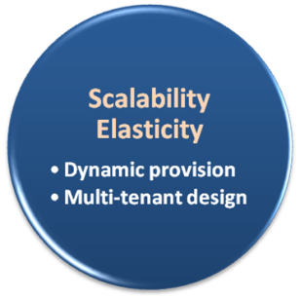
Scalability & Elasticity
What is scalability ?
A desirable property of a system, a network, or a process, which indicates its ability to either handle growing amounts of work in a graceful manner or to be readily enlarged.
What is elasticity ?
The ability to apply a quantifiable methodology that allows for the basis of an adaptive introspection with in a real time infrastructure.
But how to achieve these properties ?
Dynamic provisioning
Multi-tenant design

Slide 126
Dynamic Provisioning
What is dynamic provisioning ?
Dynamic Provisioning is a simplified way to explain a complex networked server computing environment where server computing instances are provisioned or deployed from a administrative console or client application by the server administrator, network administrator, or any other enabled user.

Slide 127
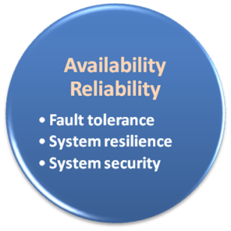
Availability & Reliability
What is availability ?
The degree to which a system, subsystem, or equipment is in a specified operable and committable state at the start of a mission, when the mission is called for at an unknown time.
Cloud system usually require high availability
Ex. “Five Nines” system would statistically provide 99.999% availability
What is reliability ?
The ability of a system or component to perform its required functions under stated conditions for a specified period of time.
But how to achieve these properties ?
Fault tolerance system
Require system resilience
Reliable system security

Slide 128
Fault Tolerance
What is fault tolerant system ?
Fault-tolerance is the property that enables a system to continue operating properly in the event of the failure of some of its components.
If its operating quality decreases at all, the decrease is proportional to the severity of the failure, as compared to a naively-designed system in which even a small failure can cause total breakdown.
Four basic characteristics :
No single point of failure
Fault detection and isolation to the failing component
Fault containment to prevent propagation of the failure
Availability of reversion modes

Slide 129

Fault Tolerance
Single Point Of Failure (SPOF)
A part of a system which, if it fails, will stop the entire system from working.
The assessment of a potentially single location of failure identifies the critical components of a complex system that would provoke a total systems failure in case of malfunction.
Preventing single point of failure
If a system experiences a failure, it must continue to operate without interruption during the repair process.

Slide 130
Fault Tolerance
Fault Detection and Isolation (FDI)
A subfield of control engineering which concerns itself with monitoring a system, identifying when a fault has occurred and pinpoint the type of fault and its location.
Isolate failing component
When a failure occurs, the system must be able to isolate the failure to the offending component.

Slide 131
Fault Tolerance
Fault Containment
Some failure mechanisms can cause a system to fail by propagating the failure to the rest of the system.
Mechanisms that isolate a rogue transmitter or failing component to protect the system are required.
Available of reversion modes
System should be able to maintain some check points which can be used in managing the state changes.

Slide 132
System Resilience
What is resilience ?
Resilience is the ability to provide and maintain an acceptable level of service in the face of faults and challenges to normal operation.
Resiliency pertains to the system's ability to return to its original state after encountering trouble. In other words, if a risk event knocks a system offline, a highly resilient system will return back to work and function as planned as soon as possible.
Some risk events
If power is lost at a plant for two days, can our system recover ?
If a key service is lost because a database corruption, can the business recover ?

Slide 133
System Resilience
Disaster Recovery
Disaster recovery is the process, policies and procedures related to preparing for recovery or continuation of technology infrastructure critical to an organization after a natural or human-induced disaster.
Some common strategies :
Backup
Make data off-site at regular interval
Replicate data to an off-site location
Replicate whole system
Preparing
Local mirror systems
Surge protector
Uninterruptible Power Supply (UPS)

Slide 134
System Security
Security issue in Cloud Computing :
Cloud security is an evolving sub-domain of computer security, network security, and, more broadly, information security.
It refers to a broad set of policies, technologies, and controls deployed to protect data, applications, and the associated infrastructure of cloud computing.

Slide 135
System Security
Important security and privacy issues :
Data Protection
To be considered protected, data from one customer must be properly segregated from that of another.
Identity Management
Every enterprise will have its own identity management system to control access to information and computing resources.
Application Security
Cloud providers should ensure that applications available as a service via the cloud are secure.
Privacy
Providers ensure that all critical data are masked and that only authorized users have access to data in its entirety.

Slide 136
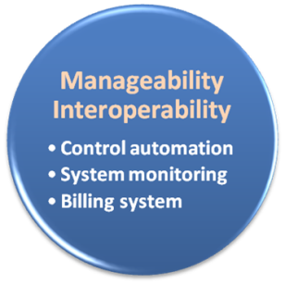
Manageability & Interoperability
What is manageability ?
Enterprise-wide administration of cloud computing systems. Systems manageability is strongly influenced by network management initiatives in telecommunications.
What is interoperability ?
Interoperability is a property of a product or system, whose interfaces are completely understood, to work with other products or systems, present or future, without any restricted access or implementation.
But how to achieve these properties ?
System control automation
System state monitoring

Slide 137
Control Automation
What is Autonomic Computing ?
Its ultimate aim is to develop computer systems capable of self-management, to overcome the rapidly growing complexity of computing systems management, and to reduce the barrier that complexity poses to further growth.
Architectural framework :
Composed by Autonomic Components (AC) which will interact with each other.
An AC can be modeled in terms of two main control loops (local and global) with sensors (for self-monitoring), effectors (for self-adjustment), knowledge and planer/adapter for exploiting policies based on self- and environment awareness.

Slide 138
Control Automation
Four functional areas :
Self-Configuration
Automatic configuration of components.
Self-Healing
Automatic discovery, and correction of faults.
Self-Optimization
Automatic monitoring and control of resources to ensure the optimal functioning with respect to the defined requirements.
Self-Protection
Proactive identification and protection from arbitrary attacks.

Slide 139

System Monitoring
What is system monitor ?
A System Monitor in systems engineering is a process within a distributed system for collecting and storing state data.
What should be monitored in the Cloud ?
Physical and virtual hardware state
Resource performance metrics
Network access patterns
System logs
… etc
Anything more ?
Billing system

Slide 140

Billing System
Billing System in Cloud
Users pay as many as they used.
Cloud provider must first determine the list of service usage price.
Cloud provider have to record the resource or service usage of each user, and then charge users by these records.
How can cloud provider know users’ usage ?
Get those information by means of monitoring system.
Automatically calculate the total amount of money which user should pay. And automatically request money from use’s banking account.

Slide 141
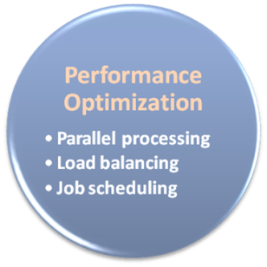
Performance & Optimization
Performance guarantees ??
As the great computing power in cloud, application performance should be guaranteed.
Cloud providers make use of powerful infrastructure or other underlining resources to build up a highly performed and highly optimized environment, and then deliver the complete services to cloud users.
But how to achieve this property ?
Parallel computing
Load balancing
Job scheduling

Slide 142
Parallel Processing
Parallel Processing
Parallel processing is a form of computation in which many calculations are carried out simultaneously, operating on the principle that large problems can often be divided into smaller ones, which are then solved concurrently.
Parallelism in different levels :
Bit level parallelism
Instruction level parallelism
Data level parallelism
Task level parallelism

Slide 143
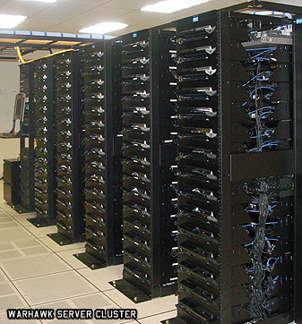
Parallel Processing
Hardware approaches
Multi-core computer
Symmetric multi-processor
General purpose graphic processing unit
Vector processor
Distributed computing
Cluster computing
Grid computing
Software approaches
Parallel programming language
Automatic parallelization

Slide 144

Load Balancing
What is load balancing ?
Load balancing is a technique to distribute workload evenly across two or more computers, network links, CPUs, hard drives, or other resources, in order to get optimal resource utilization, maximize throughput, minimize response time, and avoid overload.
Why should be load balanced ?
Improve resource utilization
Improve system performance
Improve energy efficiency
Unbalanced

Slide 145
Job Scheduling
What is job scheduler ?
A job scheduler is a software application that is in charge of unattended background executions, commonly known for historical reasons as batch processing.
What should be scheduled in Cloud ?
Computation intensive tasks
Dynamic growing and shrinking tasks
Tasks with complex processing dependency
How to approach ?
Use pre-defined workflow
System automatic configuration

Slide 146
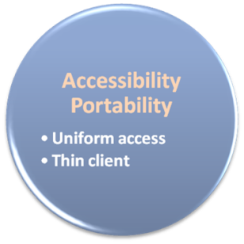
Accessibility & Portability
What is accessibility ?
Accessibility is a general term used to describe the degree to which a product, device, service, or environment is accessible by as many people as possible.
What is service portability ?
Service portability is the ability to access services using any devices, anywhere, continuously with mobility support and dynamic adaptation to resource variations.
But how to achieve these properties ?
Uniform access
Thin client

Slide 147
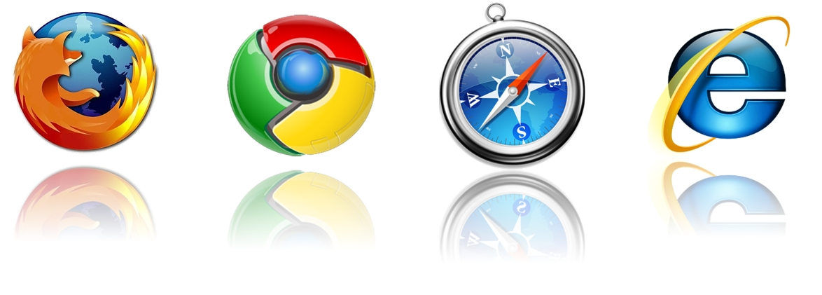
Uniform Access
How do users access cloud services ?
Cloud provider should provide their cloud service by means of widespread accessing media. In other word, users from different operating systems or other accessing platforms should be able to directly be served.
Nowadays, web browser technique is one of the most widespread platform in almost any intelligent electronic devices. Cloud service take this into concern, and delivery their services with web-based interface through the Internet.

Slide 148
Thin Client
What is thin client ?
Thin client is a computer or a computer program which depends heavily on some other computer to fulfill its traditional computational roles. This stands in contrast to the traditional fat client, a computer designed to take on these roles by itself.
Characteristics :
Cheap client hardware
While the cloud providers handle several client sessions at once, the clients can be made out of much cheaper hardware.
Diversity of end devices
End user can access cloud service via plenty of various electronic devices, which include mobile phones and smart TV.
Client simplicity
Client local system do not need complete operational functionalities.

Slide 149

What is cloud computing ?
What can we gain from cloud ?

Slide 150

Benefits From Cloud
Cloud computing brings many benefits :
For the market and enterprises
Reduce initial investment
Reduce capital expenditure
Improve industrial specialization
Improve resource utilization
For the end user and individuals
Reduce local computing power
Reduce local storage power
Variety of thin client devices in daily life

Slide 151
Reduce Initial Investment
Traditional process of enterprises to initiate business :
Survey and analysis the industry and market
Estimate the quantity of supply and demand
Purchase and deploy IT infrastructure
Install and test the software system
Design and develop enterprise specific business service
Announce the business service to clients
Some drawbacks :
The survey, analysis and estimation may not 100% correct
Infrastructure deployment is time consuming
Enterprises should take the risk of wrong investment

Slide 152
Reduce Initial Investment
Initiate business with Cloud Computing services :
Survey and analysis the industry and market
Chose one cloud provider for enterprise deployment
Design and develop business service upon cloud environment
Announce the business service to clients
Some benefits :
Enterprise do not need to own the infrastructure
Enterprise can develop and deploy business service in short time
Enterprise can reduce the business loss of wrong investment

Slide 153

Reduce Initial Investment
What dose cloud computing achieve ?
 | Traditional | With Cloud Computing
Investment Risk | Enterprise takes the risk | Cloud reduces the risk
Infrastructure | Enterprise owns the infrastructure | Cloud provider owns the infrastructure
Time duration | Long deployment time | Fast to business ready

Slide 154
Reduce Capital Expenditure
Traditional capital expenditure of enterprises :
Each enterprise should establish its own IT department
IT department should handle the listing jobs
Manage and administrate hardware and software
Apply regular data backup and check point process
Purchase new infrastructure and eliminate outdated one
Always standby for any unexpected IT problems
Some drawbacks :
Enterprise pays for IT investment which is not its business focus
Enterprise should take the risk of hardware/software malfunction
Replacing and updating infrastructure is time consuming and risky

Slide 155
Reduce Capital Expenditure
Capital expenditure with Cloud Computing service :
Enterprise can almost dismiss its IT department
The jobs of IT department can be achieved by cloud provider
Dynamically update and upgrade hardware or software
Dynamically provision and deploy infrastructure for enterprise
Automatically backup data and check consistency
Self-recover from disaster or system malfunction
Some benefits :
Enterprise can shift effort to its business focus
Enterprise can reconfigure its IT services in short time
Enterprise pays to cloud provider as many as the service used

Slide 156

Reduce Capital Expenditure
What dose cloud computing achieve ?
 | Traditional | With Cloud Computing
Business focus | Need to own its IT department | Cloud provider takes care everything
Payment | Pay for all investment and human resource | Enterprise pays as the service used
Time duration | Long establish time | Fast to business ready

Slide 157
Improve Industrial Specialization
Traditional industry and market :
Every enterprise has to own its IT department
IT resource is managed by enterprise themselves
IT complexity should be well taken care by enterprise themselves
Some drawbacks :
IT department is not the business focus of enterprise
Most of enterprises do not well maintain their IT resources
Enterprise seldom optimizes their IT resource usage

Slide 158
Improve Industrial Specialization
Collaboration with Cloud providers :
Cloud providers centrally maintain IT infrastructure for clients
Cloud providers employ experts for management and administration
Cloud providers focus on providing reliable IT services
Enterprises only rent the service they need and care
Some benefits :
Industrial specialization will be improved
IT service performance will be optimized
Enterprise business focus will be enhanced
IT resource waste will be reduced

Slide 159

Improve Industrial Specialization
What dose cloud computing achieve ?
 | Traditional | With Cloud Computing
Collaboration | Enterprise needs to take care everything | Enterprise focuses on its own business
Management | Enterprise works with poor manageability | Cloud provider applies professional control
Relationship | Stand alone enterprise | Win-Win partnership

Slide 160
Improve Resource Utilization
Traditional industry and market :
Enterprise seldom takes care about IT resource utilization
Enterprise owns their IT resource without well management
IT resource usually over invested for peak demand
Some drawbacks :
Power and space utilization among enterprises are wasted
IT resources across enterprises cannot be shared

Slide 161
Improve Resource Utilization
Collaboration with Cloud providers :
IT resources are centrically managed and optimized
Cloud provider builds performance optimized hardware
Cloud provider builds consolidated cooling system
Cloud provider will consider the geographic issues
Cloud provider will consider legal policy issues
Some benefits :
IT infrastructure can be shared among enterprises
IT infrastructure performance and utilization can be optimized
Large-scale integrated optimization can be applied

Slide 162

Improve Resource Utilization
What dose cloud computing achieve ?
 | Traditional | With Cloud Computing
IT Resource Utilization | IT resource under utilized most of time | Share to improve utilization of IT resource
Power Consumption | Waste power and cooling system | Cloud system should be global optimized

Slide 163
Reduce Local Computing Power
Traditional local computing power requirement :
One need to buy your own personal computer
Buy powerful processor if you need intensive computing
Buy large memory to meet application requirement
Install plenty of applications in need
Some drawbacks :
One can hardly replicate the same system environment
One needs to regularly update or upgrade software and hardware
One needs to reinstall all applications if you reinstall the OS

Slide 164
Reduce Local Computing Power
Using Cloud Computing services :
One can utilize the remote computing power in the cloud
One needs only basic computing power to connect to internet
Application in the cloud will automatically upgrade
Some benefits :
One can access his/her applications anywhere through the Internet
One can dynamically request for computing power on demand
Application may need not to be reinstalled even reinstall the OS

Slide 165

Reduce Local Computing Power
What dose cloud computing achieve ?
 | Traditional | With Cloud Computing
Hardware Requirement | User needs to buy powerful hardware | Only basic hardware to connect to internet
Software Requirement | Install application in local computer | No local installation requirement
Portability | Hard to be portable | Natively portable

Slide 166
Reduce Local Storage Power
Traditional local storage power requirement :
User programs and data files are stored in local devices
User has to backup data regularly preventing hardware damage
Some drawbacks :
Storage space may not enough for burst data requirement
Storage space may be over needed which result in resource waste
Data consistency is hard to maintain between computers
Need to sacrifice part of storage space for data backup

Slide 167
Reduce Local Storage Power
Using Cloud Computing services :
User programs and data files are stored in the cloud
Cloud service provider will guarantee the data availability
Some benefits :
One can dynamically allocate storage space on demand
One can access data anywhere through the Internet
No need to care about data consistency between computers
No need to care about data loss due to hardware damage

Slide 168

Reduce Local Storage Power
What dose cloud computing achieve ?
 | Traditional | With Cloud Computing
Storage Space | Limited to local disk, may be under utilized | Dynamically allocated on demand
Storage Data Consistency | Difficult to maintain data consistency | Data consistency maintained by cloud
Availability | Regular user backup | Cloud service guarantee

Slide 169
Variety of End Devices
Traditional computing resource :
One can connect to the Internet by personal computer
Only personal computer can deliver reasonable computing power
Small devices cannot perform incentive computation due to their power and hardware limitation
Some drawbacks :
Computing power is not portable
Small devices can only perform simplified works

Slide 170
Variety of End Devices
Devices collaborate with Cloud services :
Device connects to the Internet through wireless network
Device accesses cloud services through web service interface
Device sends computing incentive jobs into cloud and wait for results
Some benefits :
User can easily access cloud service through small devices
User can access almost unlimited computing power anywhere
Small devices can be intelligently managed through cloud

Slide 171

Variety of End Devices
What dose cloud computing achieve ?
 | Traditional | With Cloud Computing
Computing Power | Only accessed through desktop computer | Accessed through small smart devices
Small Device Intelligence | Functionalities was limited due to their power consumption | Shift computing incentive jobs into cloud, and then wait for results

